Slide 1
Vehicle Rental System
By Amrit Anand Singh

Slide 2
Problem Statement
The Vehicle Rental System project involves creating user-friendly software to manage vehicle rentals. It includes features like vehicle and customer management, booking and rental processes, administrative functions, return and invoicing procedures, error handling, testing, and a polished user interface. The aim is to automate rental agency operations, from reservations to revenue tracking, providing both customers and staff with an efficient platform.

Slide 3
Method and Technology Used
Git
Spiral Model
SOLID Principle
Coding Standards
Design pattern
oops
Testing
Validation
Smart Pointers
STL
Other oops concepts

Slide 4
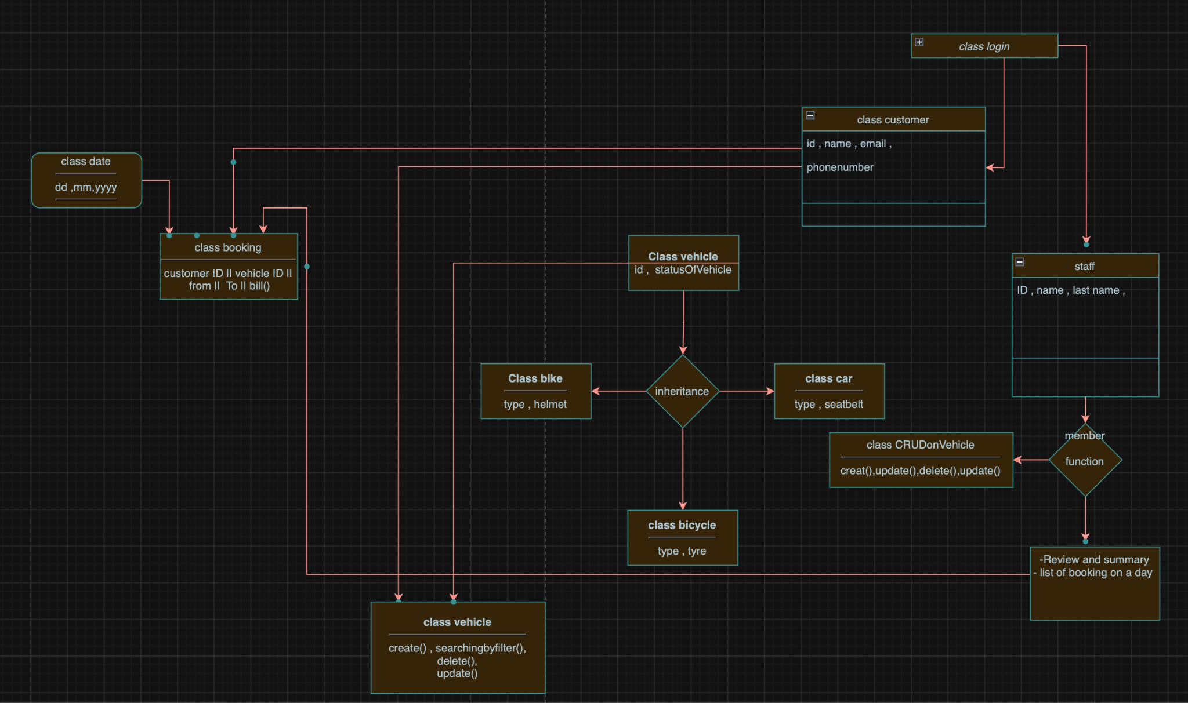
Class Diagram

Slide 5
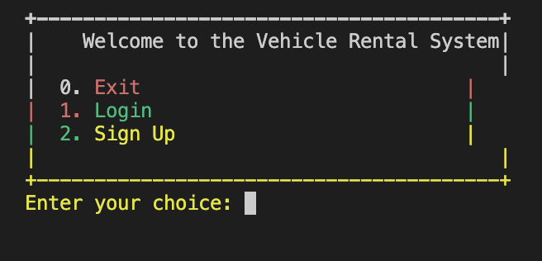
Login Page

Slide 6
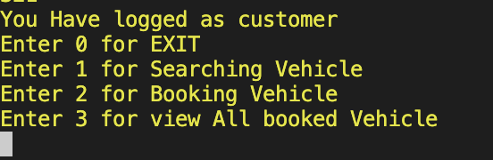
Customer Home Page

Slide 7
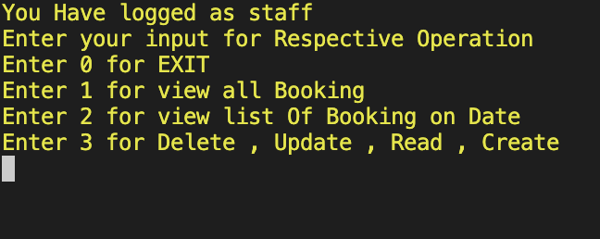
Staff Home Page

Slide 8
Reference
https://devdocs.io/cpp/
https://cplusplus.com/doc/
https://en.cppreference.com/w/
https://github.com/

